Slide 1

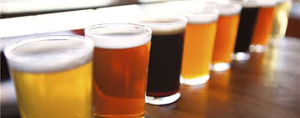
Market Intelligence
GJ Brewhouse
“Let Data Lead the Way”

Slide 2
Craft Brew – Market Intelligence
“Let Data Lead the Way”

Slide 3
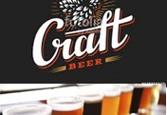
ABOUT US
Ganesh Kodi –
Jeff Leath–
Leading Data Scientist who tutored under world renown Data Scientist, Jacquelyn Cheun.

Slide 4
PROBLEM
GJ Brewhouse, a startup microbrewery, is researching the existing ‘craft brew’ market in the US. They have raised funds that will allow them to grow and they want to survey the landscape to identify space to fill a niche.
GJ Brewhouse has commissioned market research from leading Data Scientist, Ganesh and Jeff

Slide 5

SOLUTION Advanced Analytics
R
Open-source library packages used:
plyr
tidyr
dplyr
base
ggplot2
Tableau

Slide 6

Results
“Let Data Lead the Way”
Breweries in the States
Data Snap-Shot
How many breweries are present in each state?
Merge beer data with the breweries data. Print the first 6 observations and the last six observations to check the merged file.
Data Quality
ABV/IBU
Report the number of NA's in each column.
Compute the median alcohol content and international bitterness unit for each state. (bar chart)
High Points
ABV Statistics
Which state has the maximum alcoholic (ABV) beer? Which state has the most bitter (IBU) beer?
Summary statistics for the ABV variable.
Relationship
Is there an apparent relationship between the bitterness of the beer and its alcoholic content? (scatter plot)

Slide 7
Definitions
International Bitterness Units (IBUs):
International Bitterness Units (IBUs): 1 bitterness unit = 1 milligram of isomerized (exposed to heat) hop alpha acids in one liter of beer. Can range from 0 (lowest—no bitterness) to above 100 IBUs. Usually the general population cannot perceive bitterness above or below a specific range of IBUs (said to be below 8 and above 80 IBUs by some sources).
Alcohol By Volume (ABV)
A measurement of the alcohol content in terms of the percentage volume of alcohol per volume of beer. Caution: This measurement is always higher than Alcohol by Weight (not included in this guide). To calculate the approximate volumetric alcohol content, subtract FG from OG and divide by 0.0075.
https://www.craftbeer.com/wp-content/uploads/2014/12/craftbeerdotcom-beer-styles.pdf

Slide 8
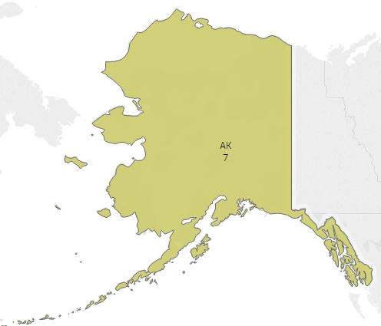
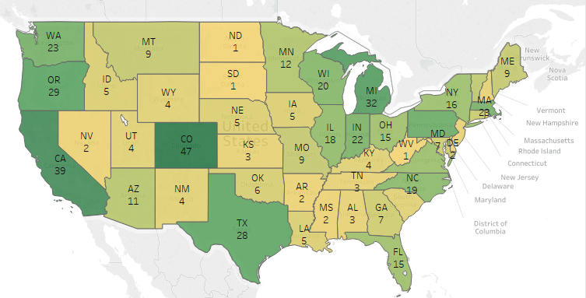
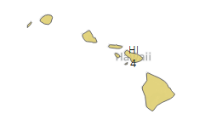
Breweries by State

Slide 9
Data Snapshot

Slide 10
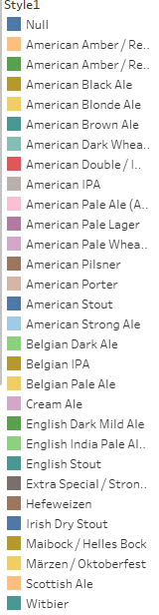
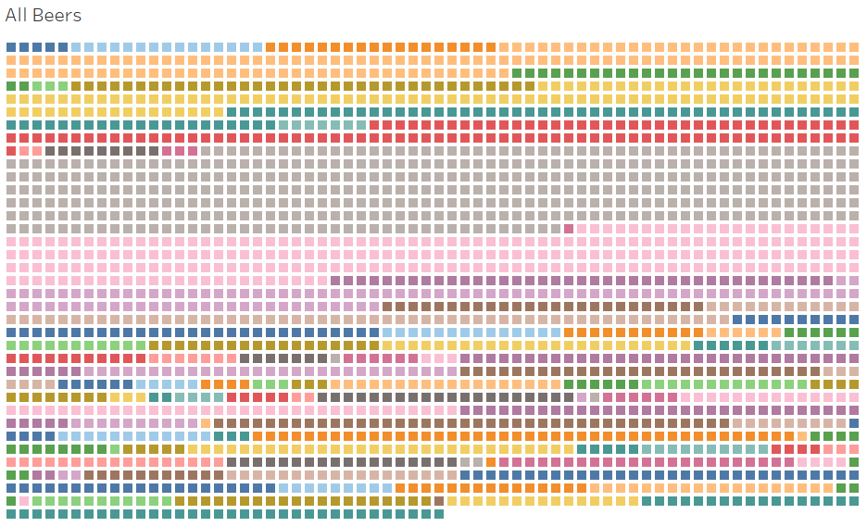
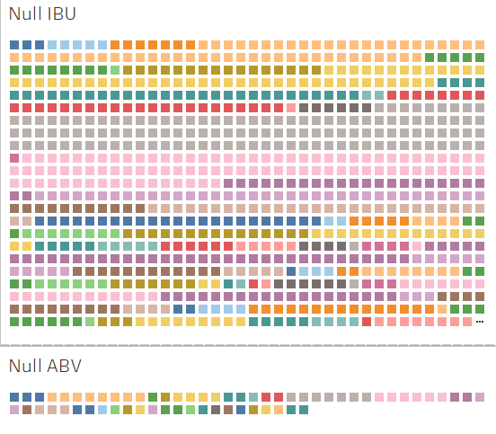
Data Quality
n = 2,410
n = 1,005
n = 62

Slide 11
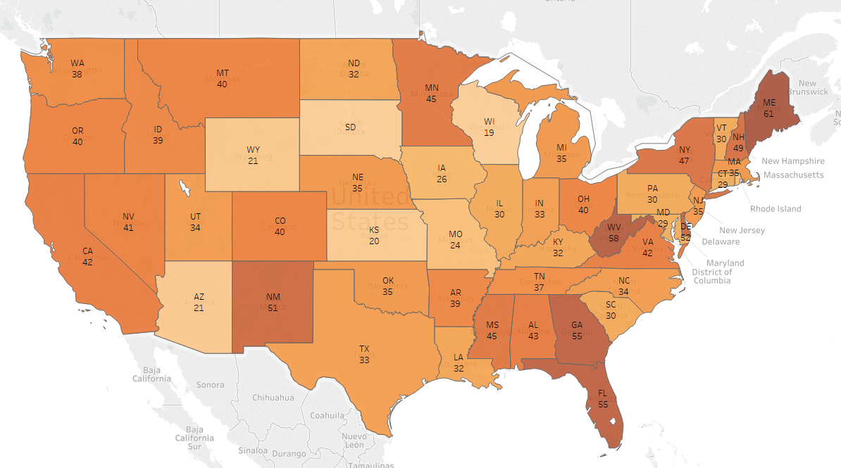
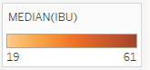
Median IBU

Slide 12
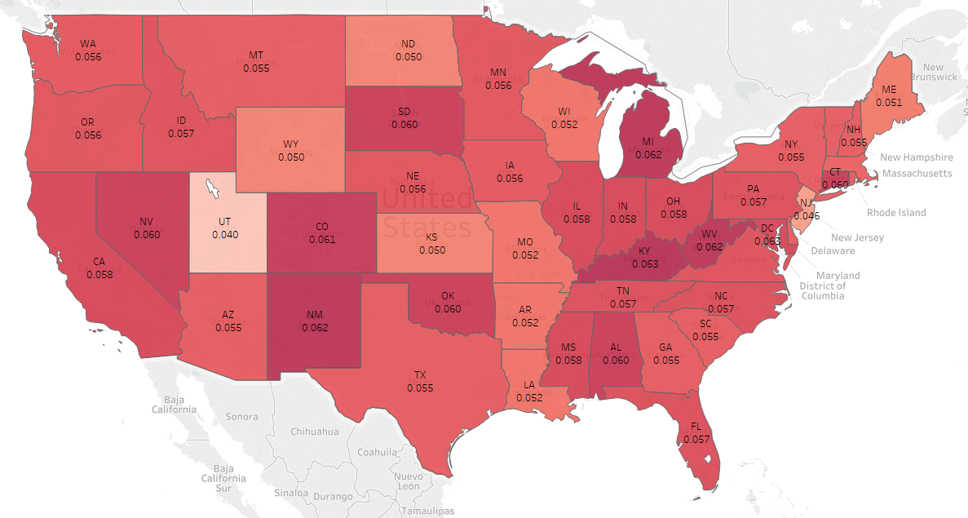
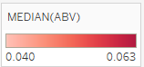
Median ABV

Slide 13
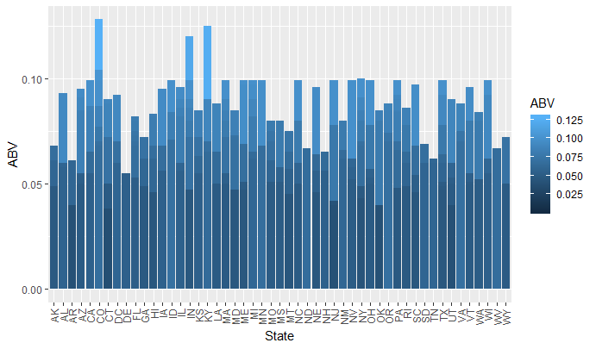
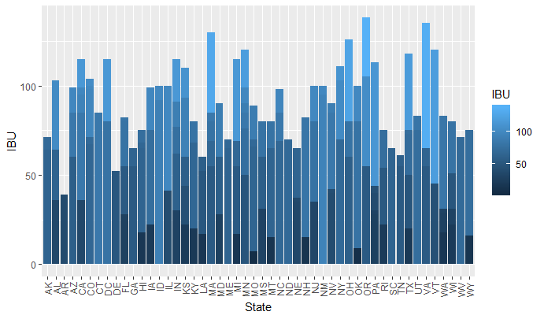
Deviations by State
ABV
IBU

Slide 14
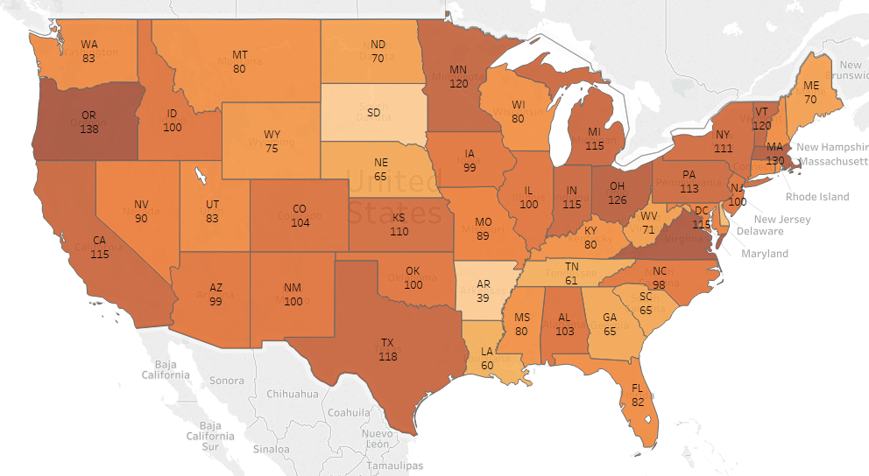
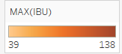
Max IBU

Slide 15
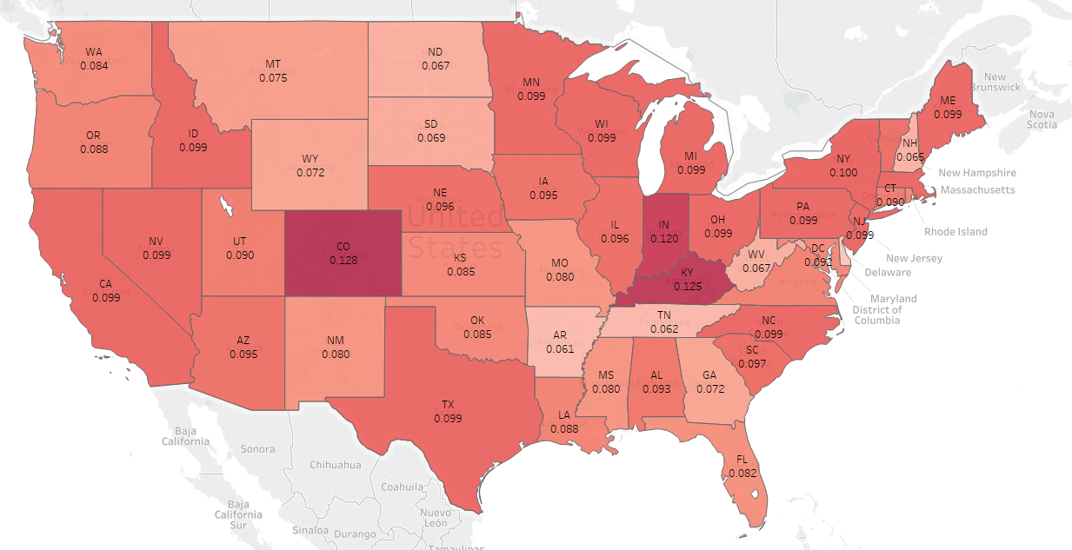
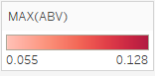
Max ABV

Slide 16
Summary Statistics of the AVB Variable
Min | 1st Quadrant | Median | Mean | 3rd Quadrant | Max | NA’s
0.00100 | 0.05000 | 0.05600 | 0.05977 | 0.06700 | 0.12800 | 62

Slide 17
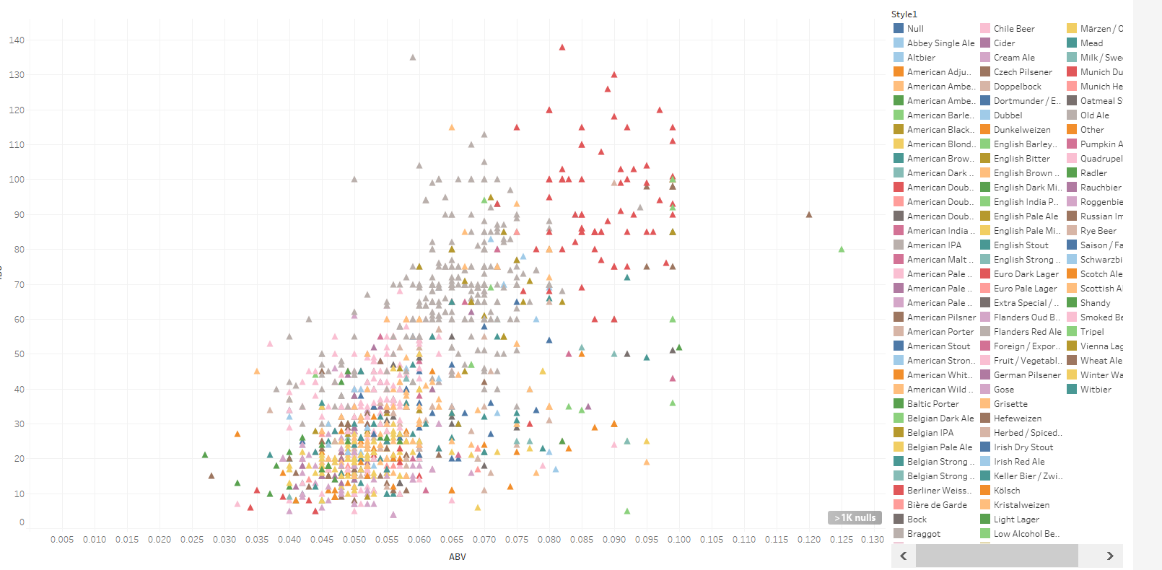
Bitterness Affect of Alcoholic Content

Slide 18
Conclusion
There is a relation between alcoholic content and bitterness unit of the beer. As alcoholic content increases bitterness increases, though there are a few exceptions.

Slide 19
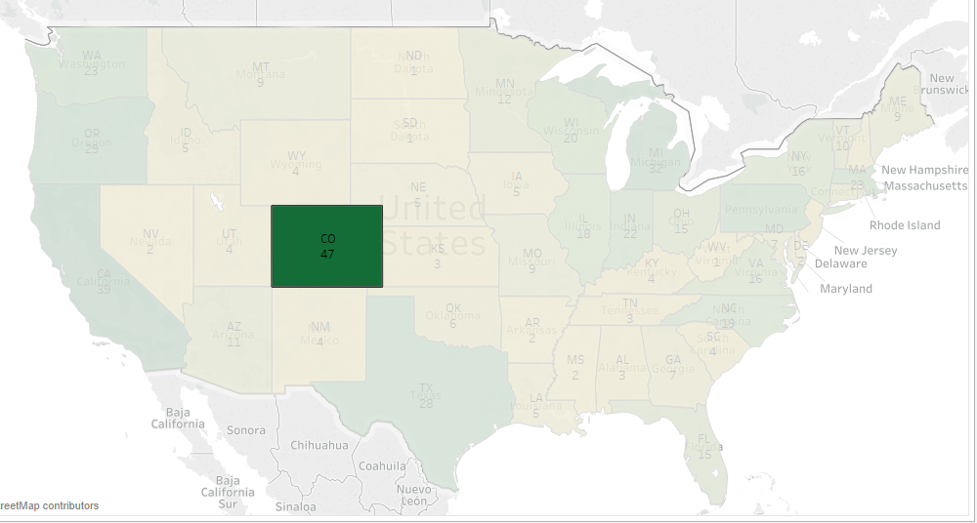
MARKET OPPORTUNITY
“Let Data Lead the Way”
Recommendation 1
With Colorado is having largest number of breweries, availability of resources and expertise make it the best location for starting new factory.

Slide 20
MARKET OPPORTUNITY
ABV
IBU
“Let Data Lead the Way”
Recommendation 2
New beer recommendation is to start with country wide average:
IBU (42.71) and ABV (0.05977)

Slide 21
THANK YOU!
Ganesh & Jeff
Email:
gkodi@smu.edu
jleath@smu.edu

